Slide 1
Unpaired Image-to-Image Translation using Cycle- Consistent Adversarial Networks
NAVEEN RAJU SREERAMA RAJU GOVINDA RAJU | A20516868
Jai Raj Choudhary | A20517449
Professor - Gady Agam
Computer Vision - CS 512

Slide 2
Outline
Problem Statement
Proposed Solution
Data
Encoder(U-Net)
Decoder (Patch GAN)
Simplified View of Architecture
Loss function
Evaluation
Results
Contribution
References

Slide 3
Problem Statement
Given any two unordered image collections X and Y , we train algorithm to learns to automatically “translate” an image from one into the other and vice versa.
In our project we have taken horses and zebras as two unordered image collections

Slide 4
Proposed Solution
We propose to implement the approach mentioned in the paper “Unpaired Image-to-Image Translation using Cycle-Consistent Adversarial Networks(Jun-Yan Zhu, Taesung Park, et al.) 2020.”
Official paper:
Generator : Is made up of several residual blocks
Discriminator : Patch level architecture
Our implementation:
Generator : Custom designed U-Net styled architecture
Discriminator : Custom designed Patch level architecture

Slide 5
Data
Training Data:
Horses: 1037
Zebra: 1034
Testing Data:
Horses: 120
Zebra: 140
Source : Kaggle CycleGAN dataset/tensorflow website

Slide 6
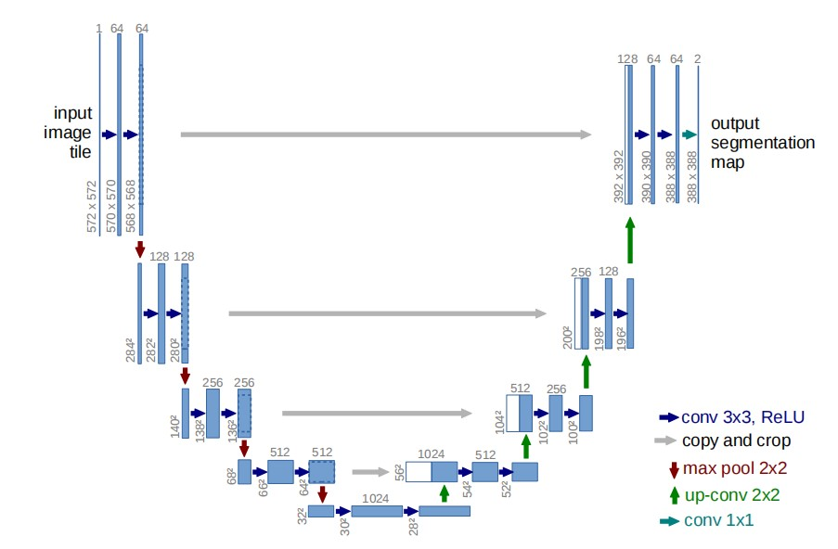
Encoder(U-Net):

Slide 7
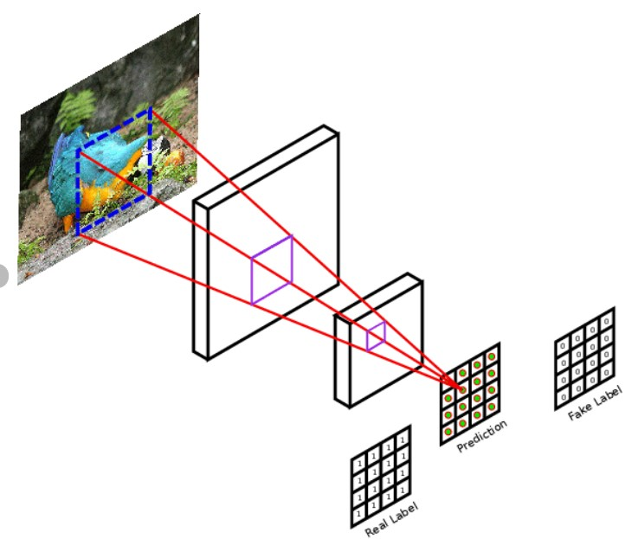
Descriminator (Patch GAN)

Slide 8
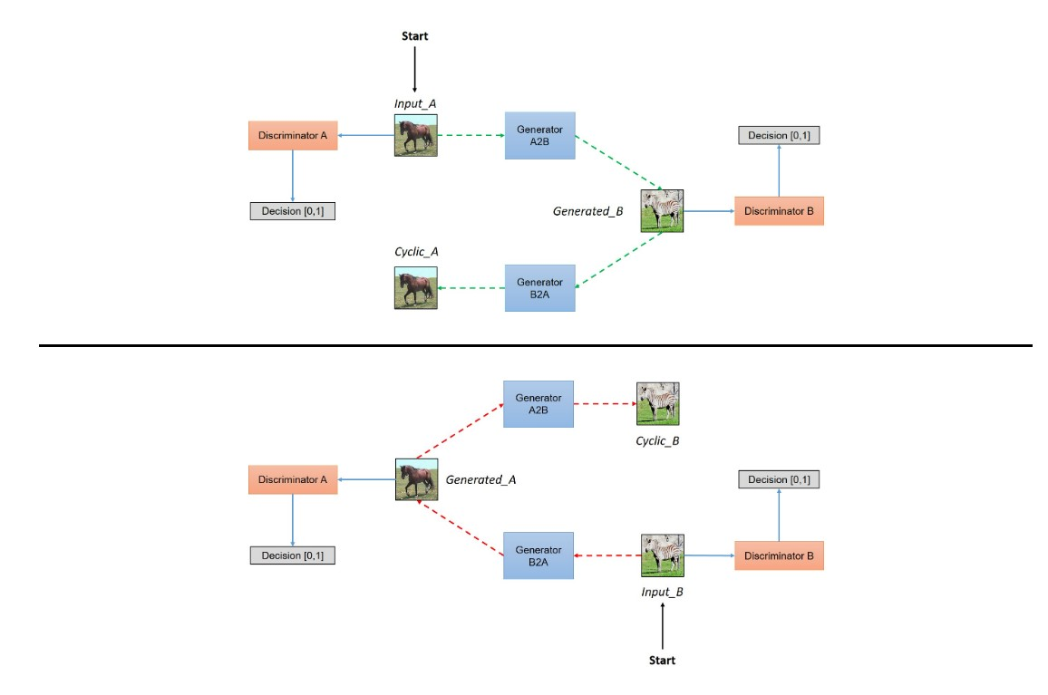
Simplified View of Architecture

Slide 9
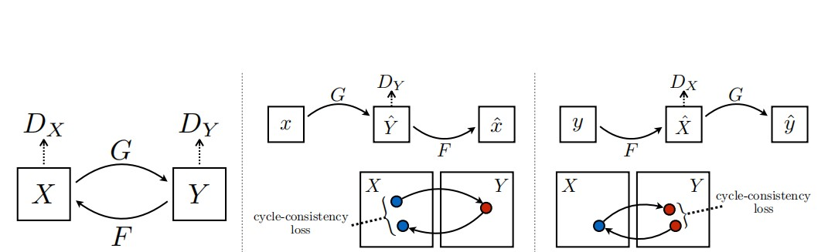
Loss function
Discriminator loss
Generator loss
Cycle loss
Identity loss
Total loss

Slide 10
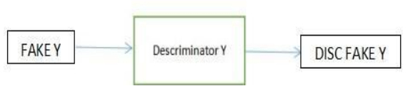
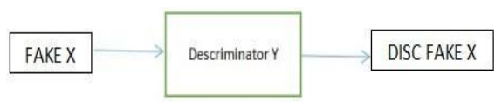
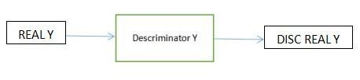
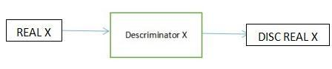
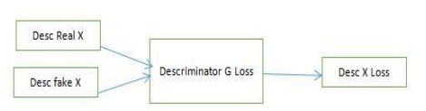
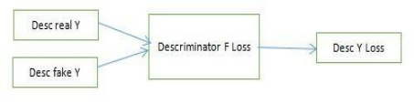
Discriminator loss

Slide 11
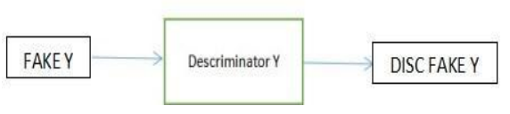
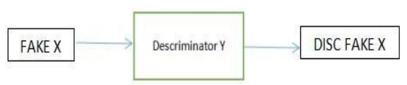
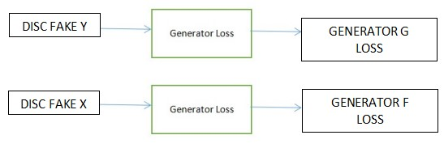
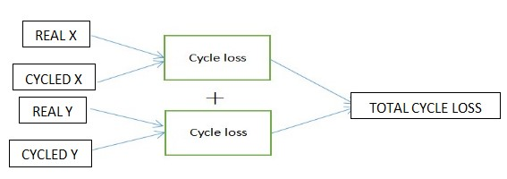
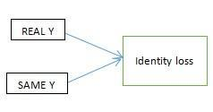
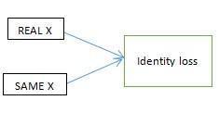
Generator loss
Cycle loss and Total loss
Identity loss
Generator G loss = gen_g_loss + total_cycle_loss + identity_loss(real_y, same_y)
Generator F loss = gen_f_loss + total_cycle_loss + identity_loss(real_x, same_x)

Slide 12
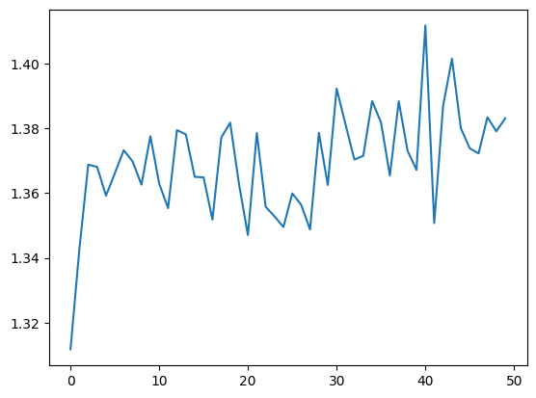
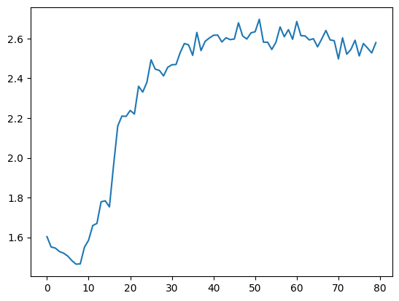
Model Loss
Model 1 Total loss Model 2 Total loss

Slide 13
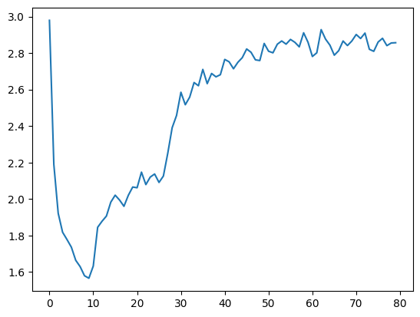
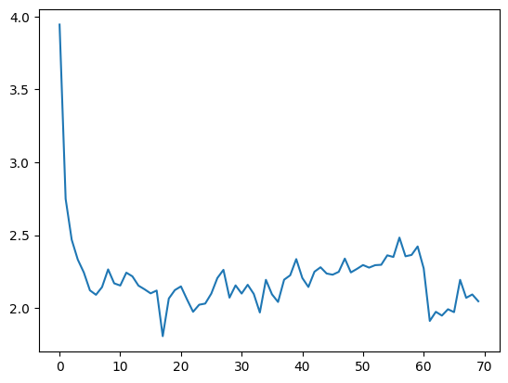
Model 3 Total loss Model 4 Total loss

Slide 14
Evaluation On Test Set (Tensor flow)
Model | Cycle loss | Mean absolute error (0 to +ve infinity) | SSIM (-1 to 1)
Model 1 | Horse to Zebra and Zebra to Horse Zebra to Horse and Horse to Zebra | 0.5240 0.8340 | 0.91758 0.92381
Model 2 | Horse to Zebra and Zebra to Horse Zebra to Horse and Horse to Zebra | 1.1713 1.8640 | 0.7610 0.6935
Model 3 | Horse to Zebra and Zebra to Horse Zebra to Horse and Horse to Zebra | 0.6822 0.9173 | 0.8768 0.4908
Model 4 | Horse to Zebra and Zebra to Horse Zebra to Horse and Horse to Zebra | 1.1035 0.9173 | 0.7625 0.7078

Slide 15
Evaluation On Test Set (Pytorch)
Evaluation Metric | Description
H_real | The mean of the discriminator H’s output on real horses images, calculated during training.
H_fake | The mean of the discriminator H’s output on fake horse images generated by generator H, calculated during training.
These metrics are logged using the tqdm package and printed at the end of each training epoch.
The model is trained using the Adam optimizer with a learning rate of 0.0002 and beta1=0.5, beta2=0.999.

Slide 16
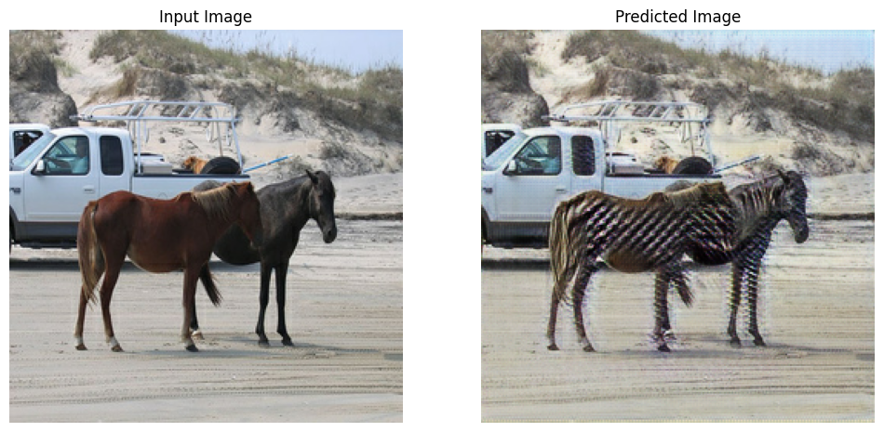
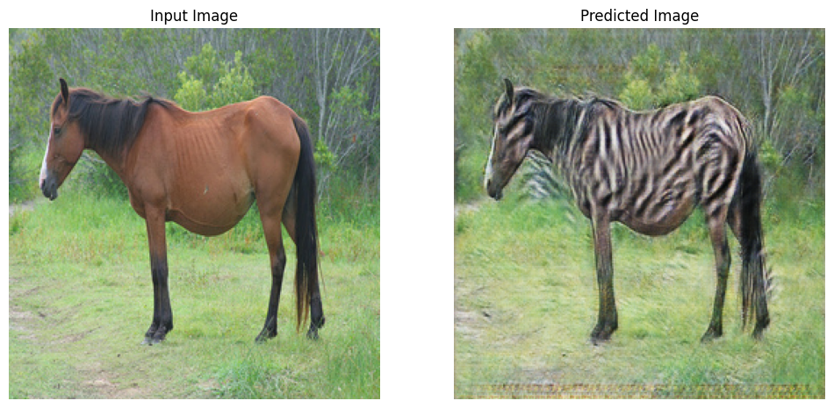
Results (Tensorflow)
Horses to Zebra

Slide 17
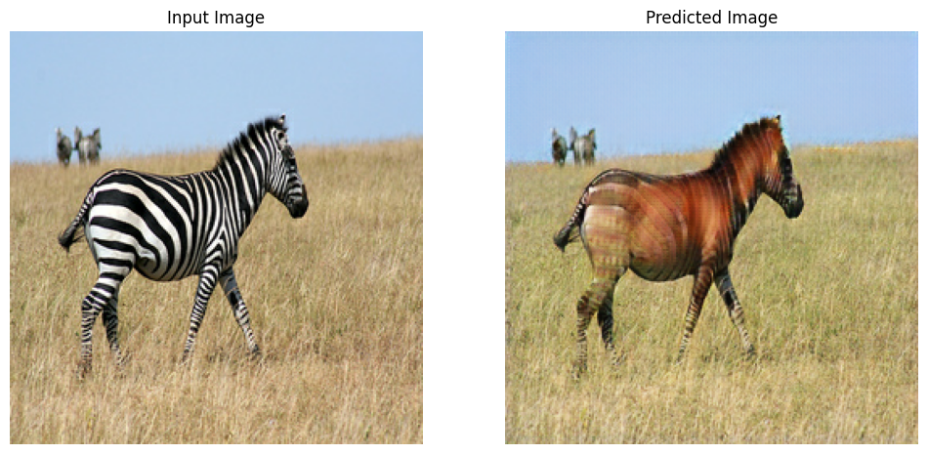
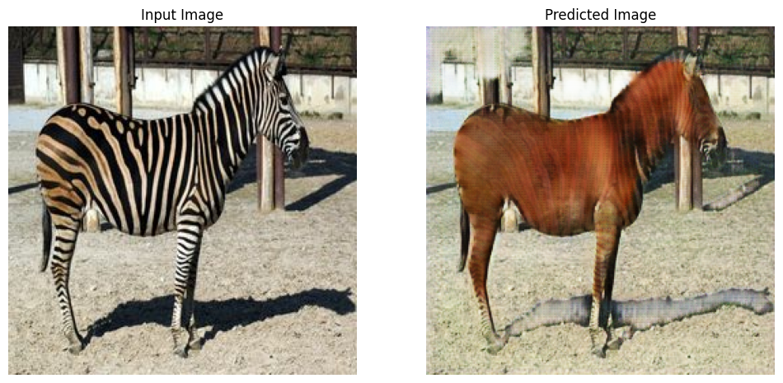
Zebra to Horses

Slide 18
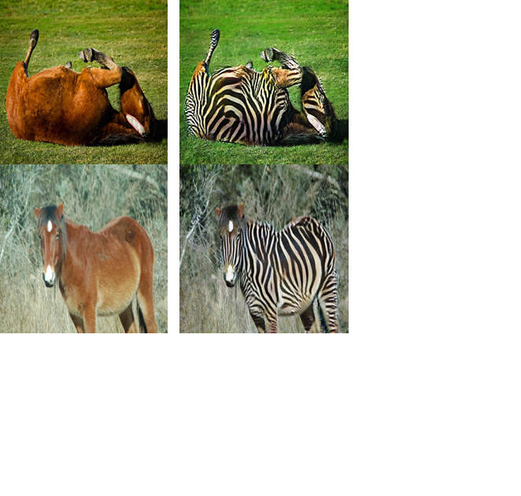
Results (Pytorch)
Horses to Zebra

Slide 19
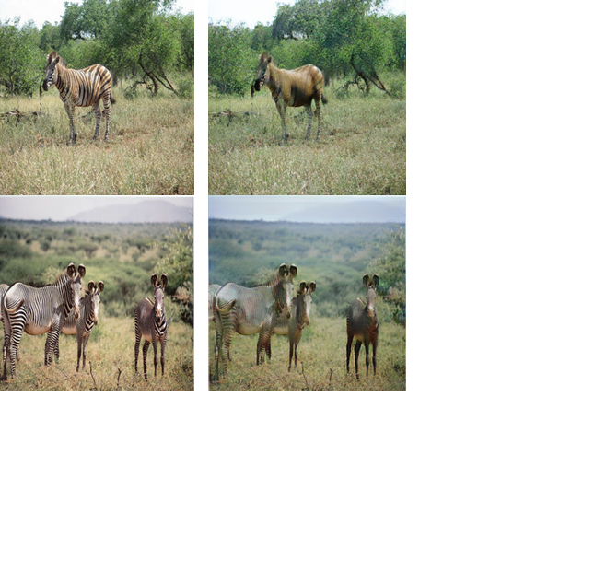
Results (Pytorch)
Horses to Zebra

Slide 20
Contribution
Task | Naveen Raju Sreerama Raju Govinda Raju |  |  |  | Jai Raj Choudhary
Problem statement analysis and Research | 50 |  |  |  | 50
Coding (Generators, Discriminators, Augmentation pipeline, Model Evaluation code ) | Model1 | Model 2 | Model 3 | Model 4 | Model (Pytorch) (training, testing)
 | 100 | 100 | 100 | 100 | 100
Debugging and Testing | Model1 | Model 2 | Model 3 | Model 4 | Model
 | 100 | 100 | 100 | 100 | 100
PPT | 70 |  |  |  | 30
Report | 70 |  |  |  | 30

Slide 21
References
https://www.researchgate.net/publication/323904616_Patch-Based_Image_Inpainting_with_Generative_Adversarial_Networks (Patch-Based Image Inpainting with Generative Adversarial Networks)
https://arxiv.org/pdf/1505.04597.pdf (U-Net: Convolutional Networks for Biomedical Image Segmentation)
https://arxiv.org/pdf/1703.10593.pdf (Unpaired Image-to-Image Translation using Cycle-Consistent Adversarial Networks)
https://www.tensorflow.org/tutorials/generative/pix2pix (pix2pix GAN)
https://github.com/zhixuhao/unet (U-Net architecture)
https://github.com/tensorflow/examples/blob/master/tensorflow_examples/models/pix2pix/pix2pix.py (Instance normalisation)
https://www.tensorflow.org/tutorials/generative/cyclegan (Cycle GAN)
https://hardikbansal.github.io/CycleGANBlog/ (Cycle GAN Blog)
PyTorch implementation of CycleGAN with spectral normalization: https://github.com/christiancosgrove/pytorch-spectral-normalization-gan
Official PyTorch implementation of CycleGAN: https://github.com/junyanz/pytorch-CycleGAN-and-pix2pix
PyTorch implementation of CycleGAN with additional features: https://github.com/aitorzip/PyTorch-CycleGAN
PyTorch implementation of CycleGAN with progressive training: https://github.com/taesungp/pytorch-cyclegan-pix2pix
https://hardikbansal.github.io/CycleGANBlog/ (Cycle GAN Blog)

Slide 22
Thank You
Any Questions

